Slide 1
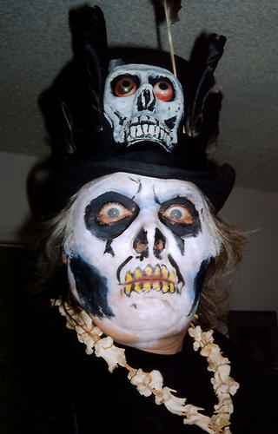
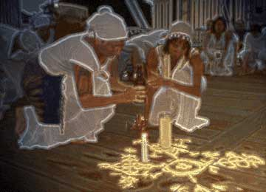
#1--heathen (he-then)
Derivatives: heathenish, heathenry
person who does not believe in a Christian God

Slide 2
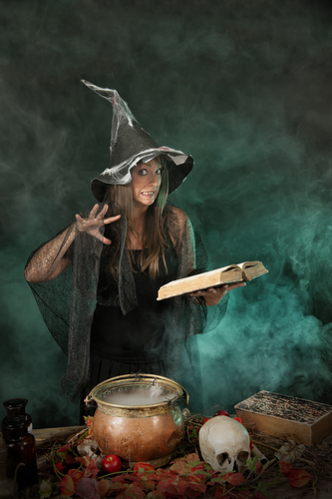
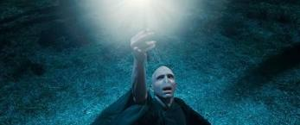
#2-- Conjure (con-joor)
Derivatives: conjurer, conjuration, conjured, conjuring
to invoke supernatural powers; to make "appear" in a supernatural way or to make something out of nothing
To make something appear

Slide 3
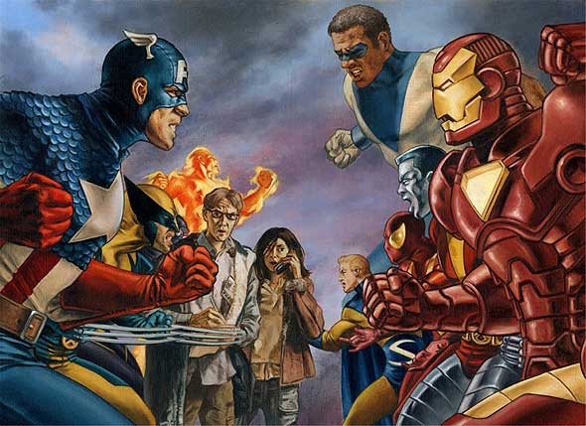
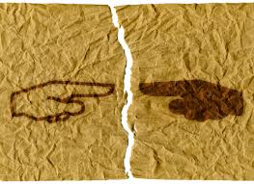
#3- Faction (fack-shun)
Derivatives: factionalism
-conflict within a group; a dissenting group of people

Slide 4
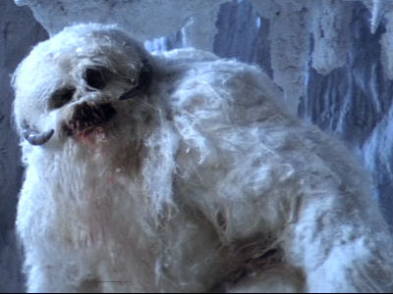
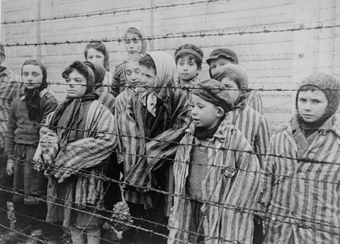
#4- Abomination (ab-ahm- -nay-shun)
Derivatives: abominated, abominable, abominably
vile, shameful, bad act; object of intense disapproval or dislike

Slide 5
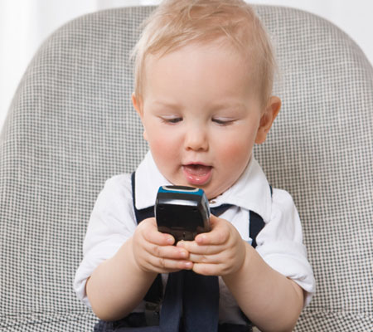
#5- Gibberish (jib-ur-ish)
Derivative: gibbering, gibbered, gibber
meaningless talking that doesn’t make sense to the person hearing it
DAWHID NANANA GOOBUF !
AWWHEEEFAAAHHDOLLLL!

Slide 6
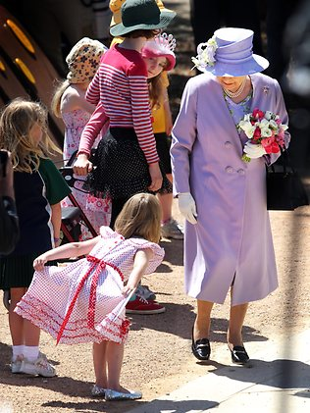
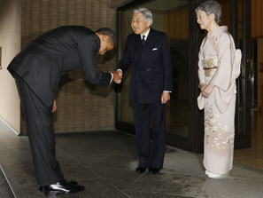
#6- Deference (deaf-her-ence)
polite respect; usually for one older or higher in society

Slide 7
#7- Naught (nawt)
Non existent; nothing

Slide 8
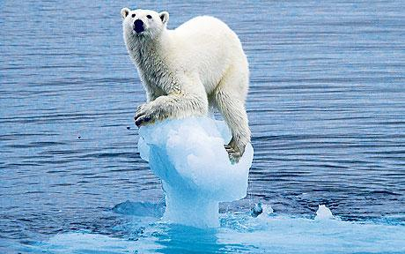
#8- Dwindling (d-wind-ling)
Derivatives: dwindle, dwindled
-to lessen or fall away; to degenerate

Slide 9
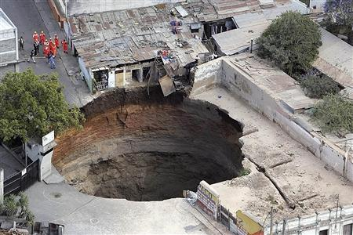
#9- Abyss (uh-biss)
Derivatives: abysmal
a large gulf or void; a large amount of empty space

Slide 10
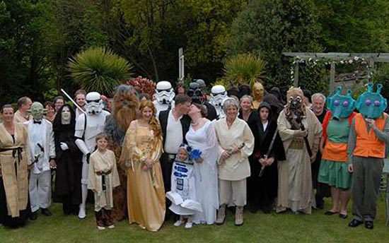
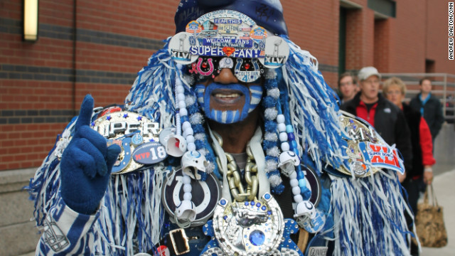
#10- Avid
Derivatives: avidly, avidity
eagerly; enthusiastically; passionately

Slide 11
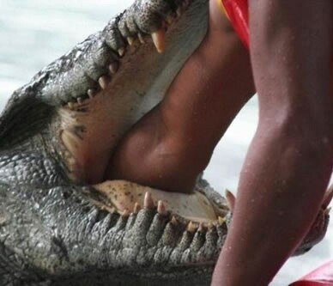
#11- Formidable (form-id-uh-bull)
Derivatives: formidably
causing fear or dread

Slide 12
#12- Intimation (in-tim-a-shun)
Derivatives: intimated,
hint or clue

Slide 13
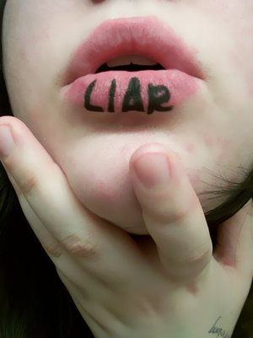
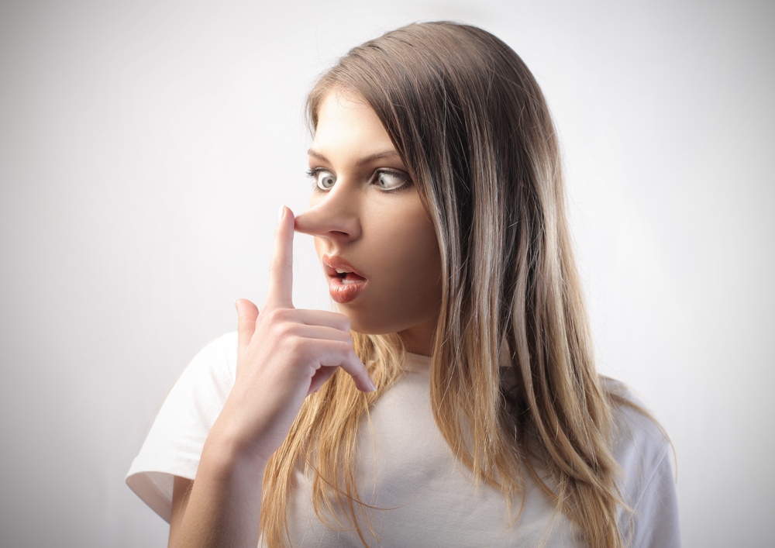
#13- Defamation (deaf-uh-may-shun)
negative untrue rumors about someone else; false accusations of sinful or improper behavior

Slide 14
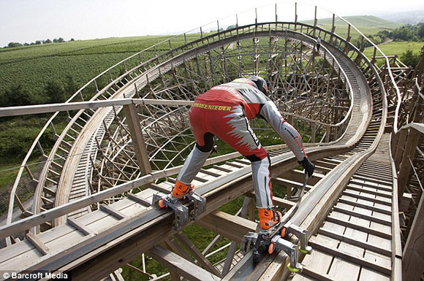
#14- Tittilate (tit-til-ate)
to excite or stimulate

Slide 15
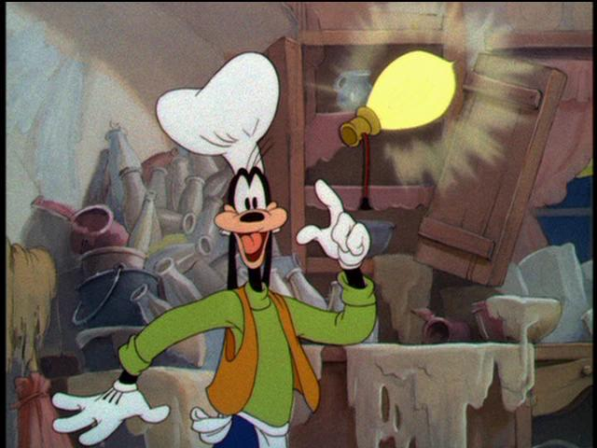
#15- Fathom
Derivative: fathomable
to understand or comprehend

Slide 16
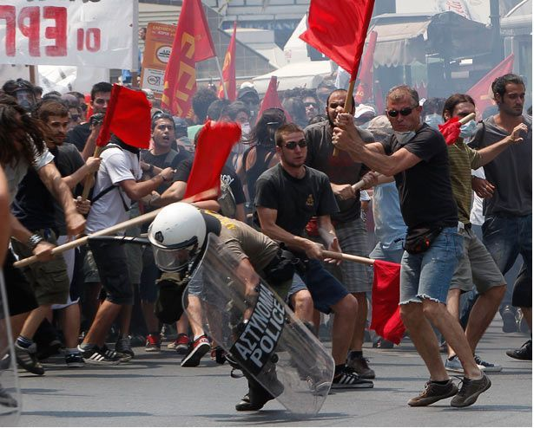
#16- Anarchy (an-ark-e)
Derivatives: anarchist, anarchistic, anarchism
lack of government or military control; complete disorder

Slide 17
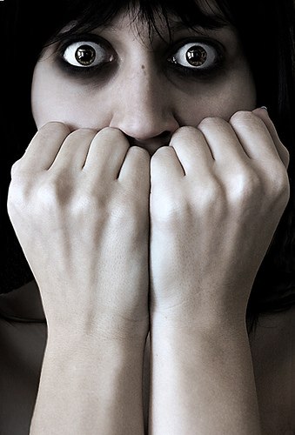
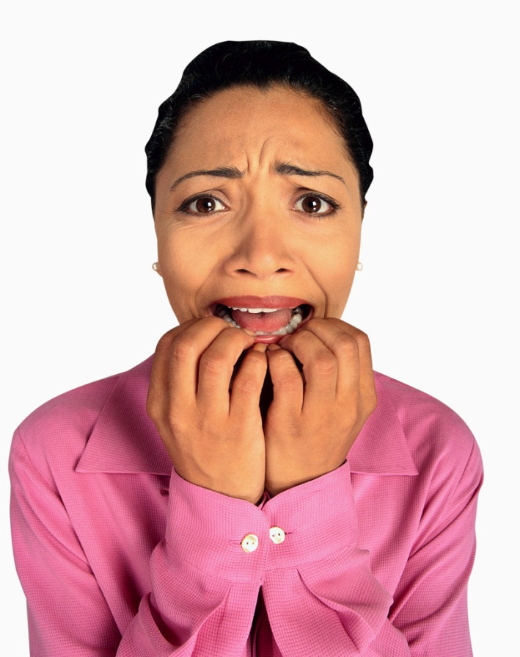
#17- Trepidation(trep-uh -day-shun)
extreme fear or nervousness

Slide 18
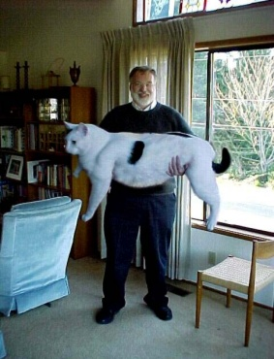
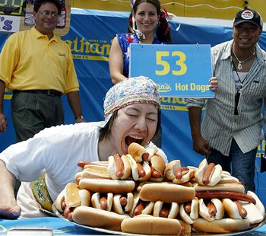
#18- Prodigious (pro-dij-us)
extraordinary amount or size; large

Slide 19
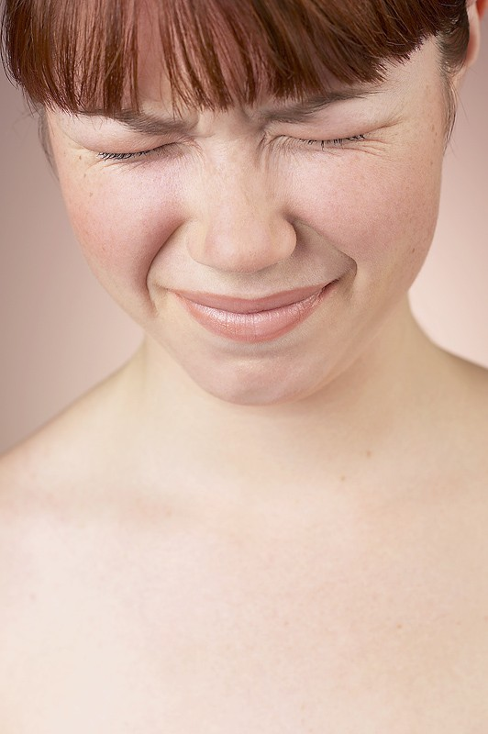
#19- Blanched (bl-an-cht)
to turn pale; to make a face as if in pain

Slide 20
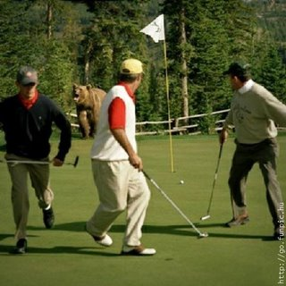
#20- Evade (e-vayd)
Derivatives: evaded, evading, evasive,
to avoid; to escape /or to be
Purposely vague or unclear

